Slide 1
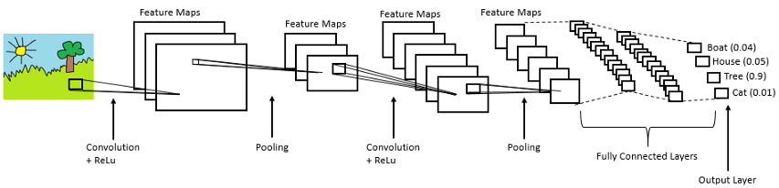
Introduction to TensorFlow for Deep Learning and Computer Vision
Damanpreet Kaur
Fall 2019

Slide 2
Table of Contents
Convolution, Pooling, and fully connected layers
The “Hello World” of TensorFlow
How to load the dataset
Writing a model
Exercise – Classification problem

Slide 3
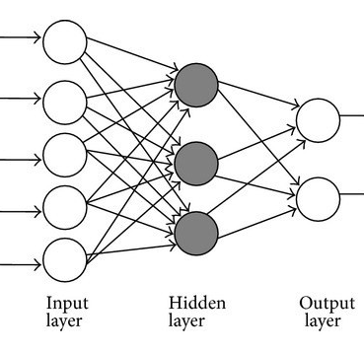
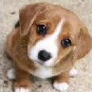
Multilayer Perceptron
Input Pixels
Disadvantage
Does not take into account the spatial position of the object
No of parameters increases with the increase in the input size.
One hidden layer with only 100 neurons for an image of size 512 X 512 X 3 has
512 X 512 X 3 X 100 = 262, 144 X 3 X 100 parameters. Can we do better?
Notes:
We do not just want to stick to images of size 64X64. Rather, we would want to work on images of large size say 1000 X 1000. So, we use CNNs for it.
https://www.coursera.org/learn/convolutional-neural-networks/lecture/Ob1nR/computer-vision

Slide 4
Convolutional Neural Networks
Made up of neurons that have learnable weights and biases.
Convolutional Neural Network is a list of layers that transforms the image volume into an output volume.
ConvNet can consist of one/more layers of the below type:
Convolutional Layers
Pooling Layers
Fully connected layers
Notes:
http://cs231n.github.io/convolutional-networks/

Slide 5
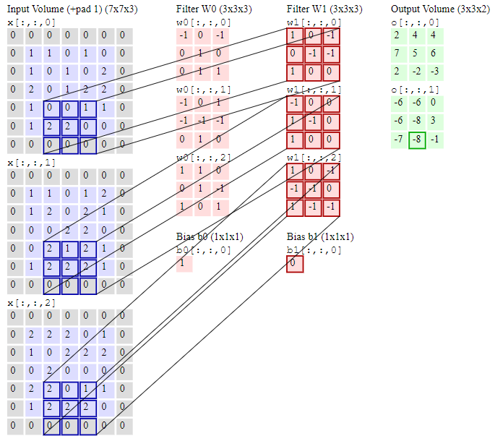
Convolutional Layer
Slide the input over the width and height of the input volume, we will produce an activation map that gives the responses of that filter at every spatial position.
Hyperparameters that control the size of the output:
Depth
Stride
Zero-padding
Pad = 1, Stride = 2, Filter size 3 X 3 X 3
Notes:
1. Depth
Number of channels in the filter (Depth of the filter) is the same as the number of channels in the input image.
For a 64 X 64 X 3 image, the filter size could be 3 X 3 X 3. Suppose you use 20 such filters, the output size will be 62 X 62 X 20.
(n + f – 1) X (n + f – 1) X nc (number of features we are detecting)
https://www.coursera.org/learn/convolutional-neural-networks/lecture/ctQZz/convolutions-over-volume
2. Stride is 1, we must move the filter 1 pixel at a time. Increasing the stride, will produce smaller output volume spatially.
Good for initial layer.
Performs convolution and down sampling at the same time, the operation becomes computationally cheaper.
3. Zero-padding helps to control the spatial size of output volume.
Two problems:
shrinking output – if we have a 100 layer neural network and output shrinks on every layer, the image we will obtain will be very small and most information will be lost.
Throwing away information from the edges of the image.
Two types of padding:
Valid – no padding
Same convolution – Output size is same as input size
n + 2p – f + 1 = n
p = (f-1)/2
https://www.coursera.org/learn/convolutional-neural-networks/lecture/o7CWi/padding

Slide 6
Why convolutional layers?
Parameter sharing
Sparsity of connections
Translation invariance
Notes:
Sparsity of connections: in each layer, each output value is connected only on small number of inputs.

Slide 7
How to calculate the output size
Input Volume size W
Receptive field size of convolutional layer F
Stride S
Amount of Zero padding P
Output size
(W – F + 2P)/S + 1
Notes:
Example – a 5x5 input with a 3X3 filter with stride 2 and pad 1, will give a 3X3 output. (See the example in the last slide)

Slide 8
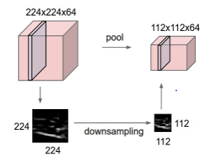
Pooling Layer
Reduce the spatial dimension by preserving the depth information.
Reduces the parameters and speed up computation.
Finding robust features.

Slide 9
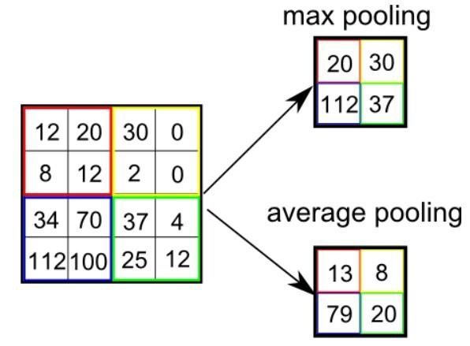
Pooling Layer
Output size
(W – F )/S + 1
Hyperparameters: s (stride) = 2, f (filter size) = 2, choose pooling type
No parameters to tune!

Slide 10
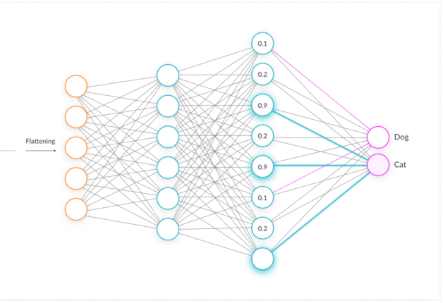
Fully connected layer
Every neuron is connected to a neuron in the previous layer, and each connection has it’s own weight.
Notes:
Sparsity of connections: in each layer, each output value is connected only on small number of inputs.
Convolutional layer provide a low-dimensional, and invariant feature space. FC layer is learning a non-linear function in that space.
https://adeshpande3.github.io/A-Beginner%27s-Guide-To-Understanding-Convolutional-Neural-Networks/

Slide 11
Google Colab
No setup needed.
Colab provides GPU and it’s totally free!
Tool for machine learning education and research
Notes:
If you have questions setting up google colab, visit:
https://research.google.com/colaboratory/faq.html
* you get free 12gb of RAM and access to a virtual machine with a high-end CPU/GPU/TPU

Slide 12
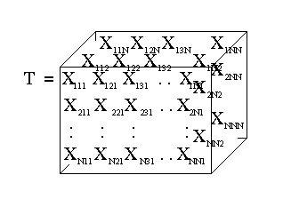
Tensorflow
TensorFlow gets its name from tensors, which are arrays of arbitrary dimensionality.
A scalar is a 0-d array (a 0th-order tensor). For example, "Howdy" or 5
A vector is a 1-d array (a 1st-order tensor). For example, [2, 3, 5, 7, 11] or [5]
A matrix is a 2-d array (a 2nd-order tensor). For example, [[3.1, 8.2, 5.9][4.3, -2.7, 6.5]]
Notes:
Tensors: https://www.youtube.com/watch?v=f5liqUk0ZTw
Open source, machine learning framework developed by Google Brain labs. Used to design, build and train neural networks.
The name “TensorFlow” is derived from the operations which neural networks perform on the multidimensional arrays/tensors.
https://www.datacamp.com/community/tutorials/tensorflow-tutorial
TensorFlow gets its name from tensors, which are arrays of arbitrary dimensionality. Using TensorFlow, you can manipulate tensors with a very high number of dimensions. That said, most of the time you will work with one or more of the following low-dimensional tensors:
A scalar is a 0-d array (a 0th-order tensor). For example, "Howdy" or 5
A vector is a 1-d array (a 1st-order tensor). For example, [2, 3, 5, 7, 11] or [5]
A matrix is a 2-d array (a 2nd-order tensor). For example, [[3.1, 8.2, 5.9][4.3, -2.7, 6.5]]
TensorFlow operations create, destroy, and manipulate tensors. Most of the lines of code in a typical TensorFlow program are operations.
A TensorFlow graph (also known as a computational graph or a dataflow graph) is, yes, a graph data structure. A graph's nodes are operations (in TensorFlow, every operation is associated with a graph). Many TensorFlow programs consist of a single graph, but TensorFlow programs may optionally create multiple graphs. A graph's nodes are operations; a graph's edges are tensors. Tensors flow through the graph, manipulated at each node by an operation. The output tensor of one operation often becomes the input tensor to a subsequent operation. TensorFlow implements a lazy execution model, meaning that nodes are only computed when needed, based on the needs of associated nodes.
Tensors can be stored in the graph as constants or variables. As you might guess, constants hold tensors whose values can't change, while variables hold tensors whose values can change. However, what you may not have guessed is that constants and variables are just more operations in the graph. A constant is an operation that always returns the same tensor value. A variable is an operation that will return whichever tensor has been assigned to it.
Reference: https://colab.research.google.com/notebooks/mlcc/tensorflow_programming_concepts.ipynb#scrollTo=VL0yWNNdgBpG

Slide 13
Tensorflow Graph
Notes:
Open source, machine learning framework by Google created and used to design, build and train neural networks.
The name “TensorFlow” is derived from the operations which neural networks perform on the multidimensional arrays/tensors.
https://www.datacamp.com/community/tutorials/tensorflow-tutorial
TensorFlow gets its name from tensors, which are arrays of arbitrary dimensionality. Using TensorFlow, you can manipulate tensors with a very high number of dimensions. That said, most of the time you will work with one or more of the following low-dimensional tensors:
A scalar is a 0-d array (a 0th-order tensor). For example, "Howdy" or 5
A vector is a 1-d array (a 1st-order tensor). For example, [2, 3, 5, 7, 11] or [5]
A matrix is a 2-d array (a 2nd-order tensor). For example, [[3.1, 8.2, 5.9][4.3, -2.7, 6.5]]
TensorFlow operations create, destroy, and manipulate tensors. Most of the lines of code in a typical TensorFlow program are operations.
A TensorFlow graph (also known as a computational graph or a dataflow graph) is, yes, a graph data structure. A graph's nodes are operations (in TensorFlow, every operation is associated with a graph). Many TensorFlow programs consist of a single graph, but TensorFlow programs may optionally create multiple graphs. A graph's nodes are operations; a graph's edges are tensors. Tensors flow through the graph, manipulated at each node by an operation. The output tensor of one operation often becomes the input tensor to a subsequent operation. TensorFlow implements a lazy execution model, meaning that nodes are only computed when needed, based on the needs of associated nodes.
Tensors can be stored in the graph as constants or variables. As you might guess, constants hold tensors whose values can't change, while variables hold tensors whose values can change. However, what you may not have guessed is that constants and variables are just more operations in the graph. A constant is an operation that always returns the same tensor value. A variable is an operation that will return whichever tensor has been assigned to it.
Reference: https://colab.research.google.com/notebooks/mlcc/tensorflow_programming_concepts.ipynb#scrollTo=VL0yWNNdgBpG

Slide 14
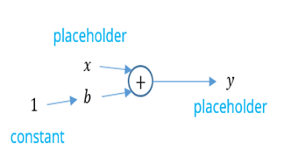
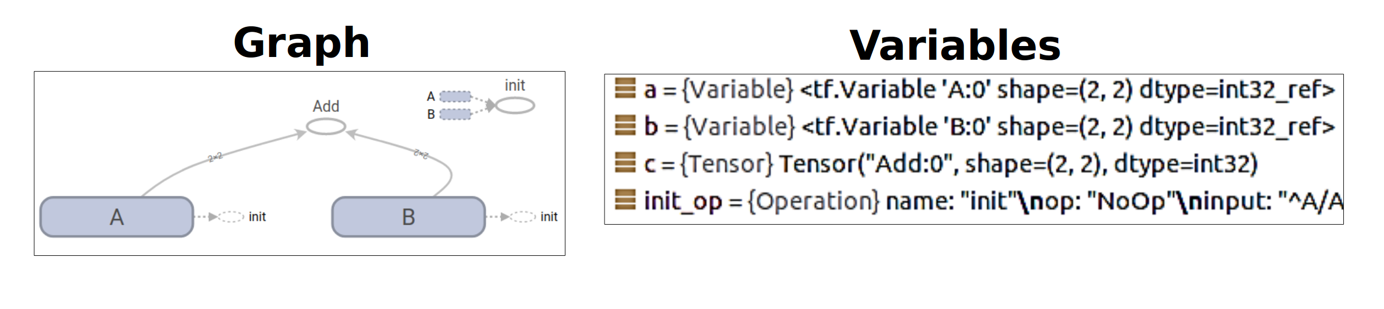
TensorFlow Basics
Constants
Placeholders
Variables
Notes:
Constant – same as in programming.
If we assign data object a value, it does not change.
Placeholder – A graph can be parameterized to accept external inputs, known as placeholders.
A promise to provide the values later.
Variable – To add trainable parameters to the graph
Use tf.global_variables_initializer() in tensorflow to initialize all variables.
https://www.tensorflow.org/guide/graphs
Graphs must run within a TensorFlow session, which holds the state for the graph(s) it runs.
When working with tf.Variables, you must explicitly initialize them by calling tf.global_variables_initializer at the start of your session, as shown above.
Note: A session can distribute graph execution across multiple machines (assuming the program is run on some distributed computation framework).
Summary
TensorFlow programming is essentially a two-step process:
Assemble constants, variables, and operations into a graph.
Evaluate those constants, variables and operations within a session.

Slide 15
Exercise
Print the concatenation of the constant hello_constant and your(or my) name.
hello_constant = “Hello world!”
Notes:
https://github.com/fabienbaradel/Tensorflow-tutorials/blob/master/Intro/hello_world.py

Slide 16
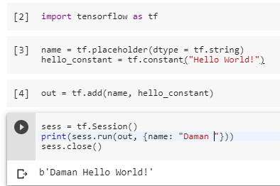
Exercise Solution
Notes:
https://colab.research.google.com/drive/12-OApYHrAqc_f8vB3NE_mKUmAPgtH-tu#scrollTo=oKVMMcf9tSl_

Slide 17
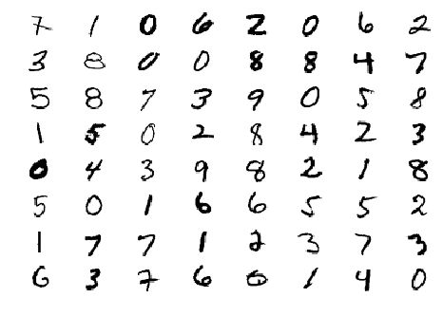
MNIST Dataset
Dataset with handwritten digits

Slide 18
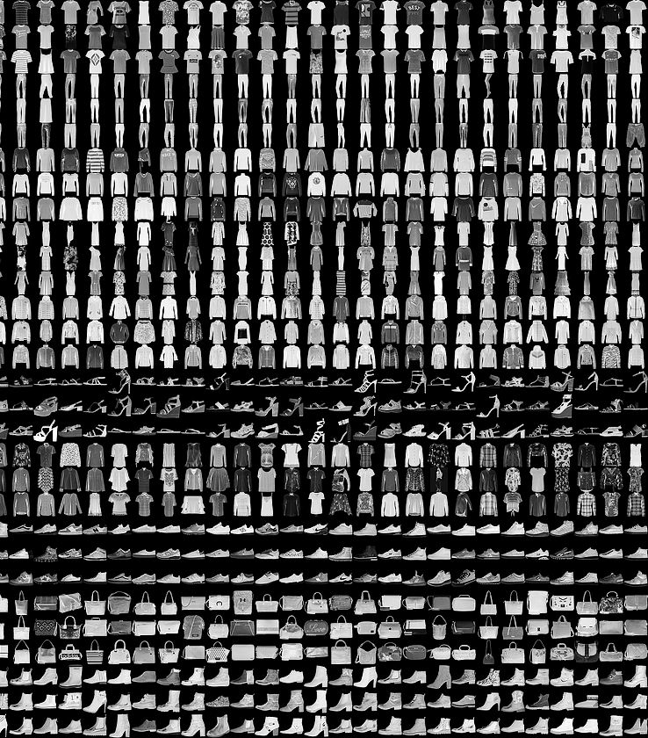
Fashion MNIST Dataset
Fashion Product Database
Notes:
Created by e-commerce company, Zalando.
Similar to the MNIST digit dataset, the Fashion MNIST dataset includes:
60,000 training examples
10,000 testing examples
10 classes
28×28 grayscale/single channel images
class labels:
0 T-shirt/top
1 Trouser/pants
2 Pullover shirt
3 Dress
4 Coat
5 Sandal
6 Shirt
7 Sneaker
8 Bag
9 Ankle boot
https://www.datacamp.com/community/tutorials/cnn-tensorflow-python

Slide 19

Let’s get coding!

Slide 20
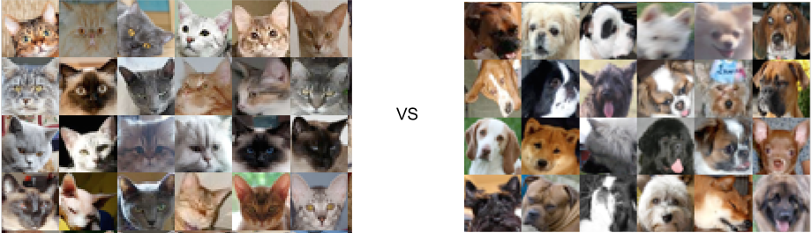
Exercise
Cats vs Dogs Classification Problem
Notes:
Classify whether the images contain either a dog or a cat.
The dataset is comprised of photos of dogs and cats provided as a subset of photos from a much larger dataset of 3 million manually annotated photos. The dataset was developed as a partnership between Petfinder.com and Microsoft. The task was referred to as “Asirra” or Animal Species Image Recognition for Restricting Access, a type of CAPTCHA.

Slide 21
References
https://towardsdatascience.com/image-classifier-cats-vs-dogs-with-convolutional-neural-networks-cnns-and-google-colabs-4e9af21ae7a8
http://cs231n.github.io/convolutional-networks/
https://www.datacamp.com/community/tutorials/tensorflow-tutorial
https://research.google.com/seedbank/guide/faq

Slide 22
Some useful links:
https://research.google.com/seedbank
http://neuralnetworksanddeeplearning.com/chap1.html

